Slide 1



CYBER FORENSIC & SECURITY SOLUTION:-
MITM Attack Exploration with Bettercap
This presentation explores the intricacies of Man-in-the-Middle (MITM) attacks, focusing on the Bettercap framework. We delve into the fundamental concepts, analyze attack techniques, and demonstrate how to implement countermeasures.
by Ahetesham Mopagar

Slide 2


What is a Man-in-the-Middle (MITM) Attack?
Interception
Eavesdropping
An attacker intercepts communication between two parties without their knowledge.
The attacker can listen to and potentially steal sensitive information transmitted between the parties.
Manipulation
The attacker can modify or alter the data exchanged between the parties, leading to data corruption or unauthorized access.

Slide 3

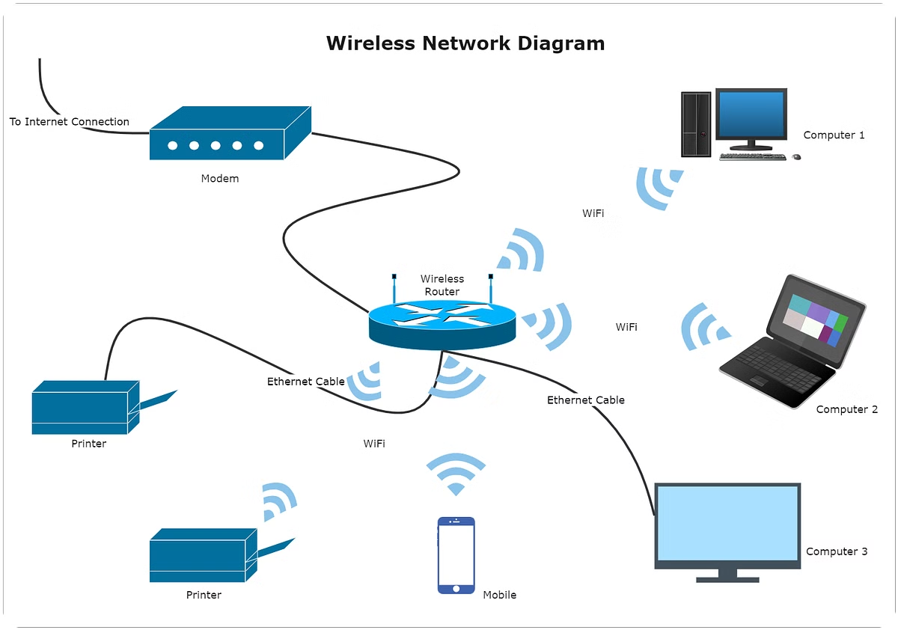
Understanding the Bettercap Framework
1
Open-Source Tool
2
Network Analysis
Bettercap is a powerful, open-source framework designed for penetration testing and security research.
Bettercap allows for comprehensive network analysis, including traffic sniffing and packet manipulation.
3
MITM Capabilities
The framework provides robust MITM capabilities, enabling attackers to intercept and modify network traffic.

Slide 4

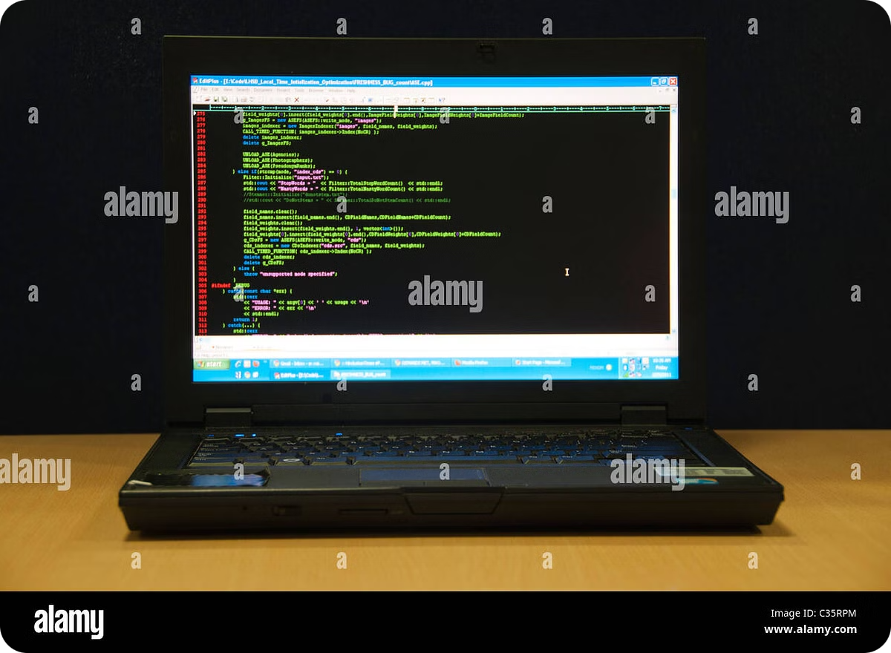



Performing MITM Attacks with Bettercap
Target Selection
Identify the target network or device you wish to attack.
Network Spoofing
Use Bettercap to impersonate the target's network access point or gateway.
Traffic Interception
Intercept and analyze network traffic between the target and other devices.

Slide 5


Analyzing MITM Attack Techniques
Technique
Description
DNS Spoofing
Redirecting DNS requests to malicious servers.
SSL Stripping
Intercepting HTTPS traffic and downgrading it to HTTP, allowing eavesdropping.
ARP Poisoning
Manipulating ARP tables to redirect traffic to the attacker.

Slide 6
Assessing the Impact of MITM Attacks
Data Theft
Data Manipulation
Denial of Service
Sensitive information like passwords, credit card details, and private messages can be stolen.
Malicious actors can modify data in transit, leading to financial losses, identity theft, or system compromises.
Attackers can disrupt communication by blocking or delaying network traffic, rendering services inaccessible.

Slide 7



Implementing Countermeasures against MITM Attacks
HTTPS Encryption
1
Using HTTPS encrypts communication between the client and server, preventing eavesdropping.
2
Strong Passwords
Complex and unique passwords make it harder for attackers to guess or crack them.
Network Segmentation
3
Dividing networks into smaller segments reduces the attack surface and limits the impact of a successful attack.
4
Security Software
Antivirus and firewall software can detect and block malicious activity, including MITM attempts.

Slide 8





Conclusion and Key Takeaways
Defense
Implement security best practices to mitigate the risks of MITM attacks.
Awareness
Stay informed about the latest threats and vulnerabilities to protect your systems.
Security
Use security tools and techniques to detect and prevent malicious activity.

